Slide 1
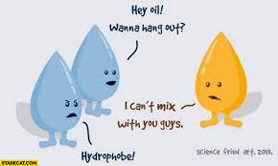

Slide 2
Unit-III
Transport Phenomena in Biological Systems:

Slide 3
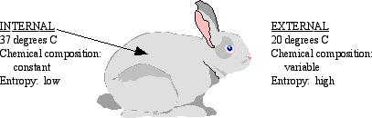
What it means to be alive..a steady state or an equilibrium?

Slide 4
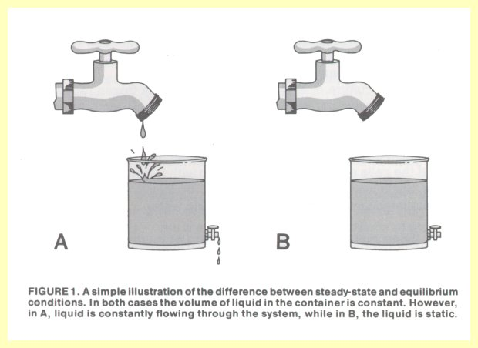
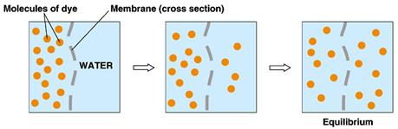
Steady State vs Equilibrium

Slide 5
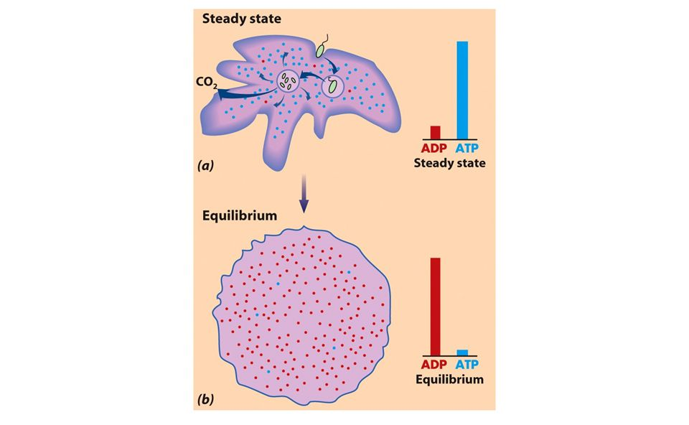
Steady State vs Equilibrium

Slide 6
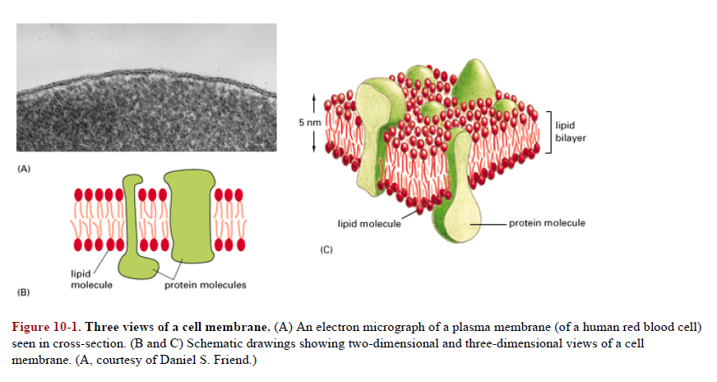
Biological Membranes

Slide 7
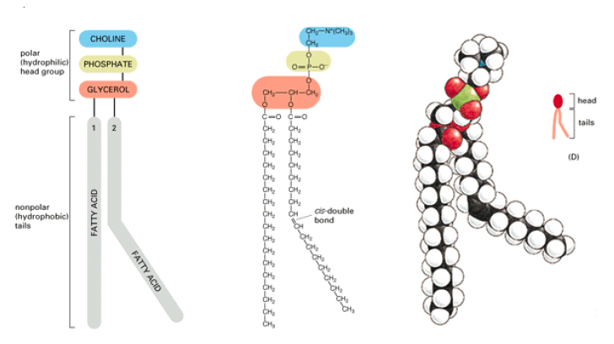
Phospholipids

Slide 8
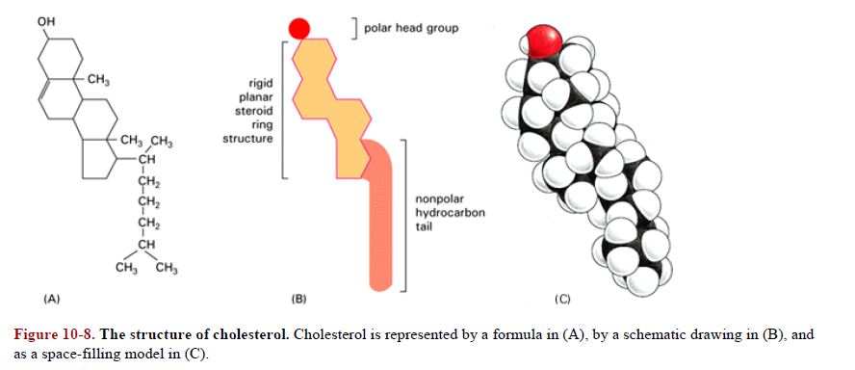
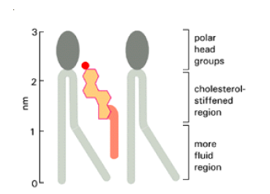
Fluidity of the membrane

Slide 9
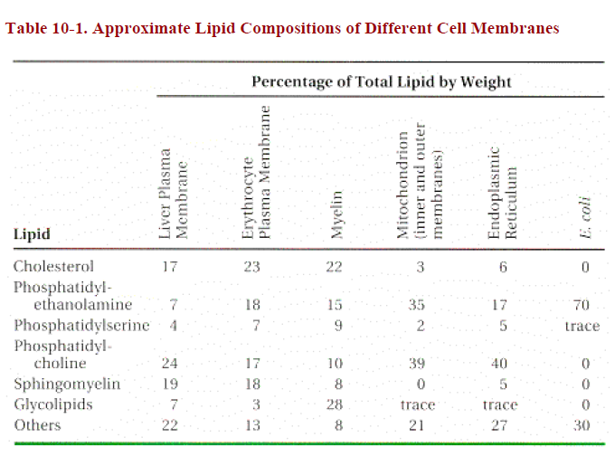
Chemical composition of the membrane

Slide 10
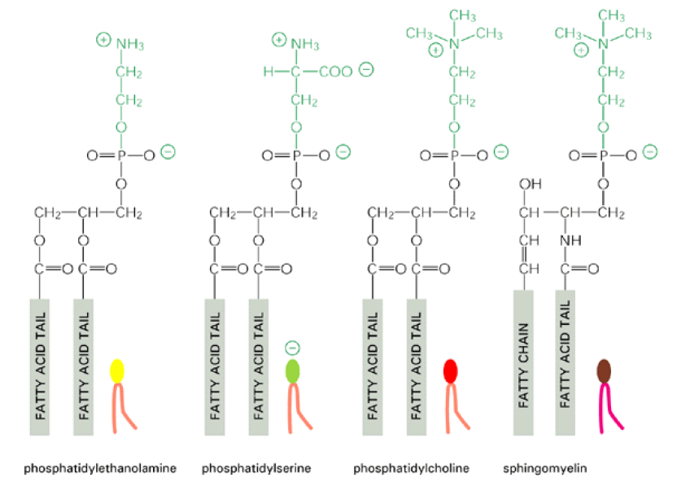
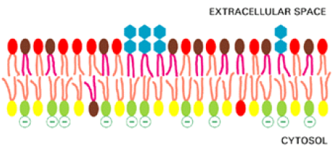
Chemical composition of the membrane

Slide 11
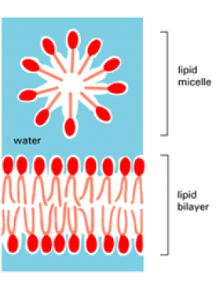
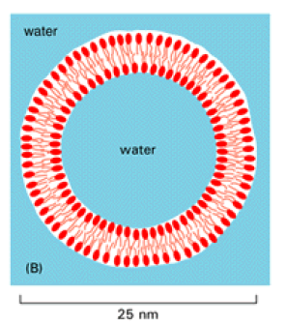
How membranes assemble in aqueous environment

Slide 12
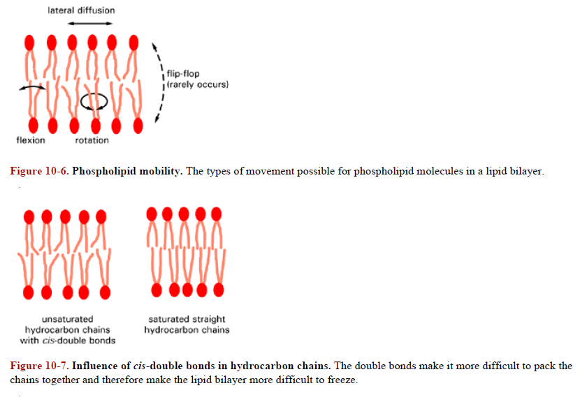
Fluidity of the membrane

Slide 13
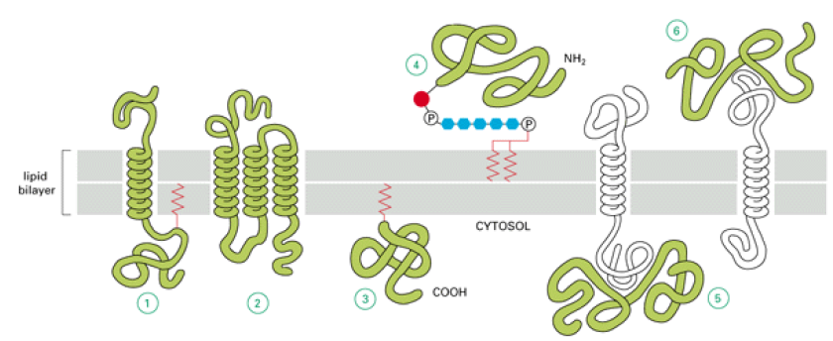
Types of proteins and their association with membrane
Extracellular matrix
Cytoplasm
Single pass – transmembrane protein
Multiple pass- transmembrane protein
Covalently attached to a FA chain or prenyl group (to the cytoplasmic side)
Covalently attached to a FA chain or prenyl group (to the extra cellular side)
Non covalent interactions (cytoplasmic side)
Non covalent interactions (Extracellular side)

Slide 14
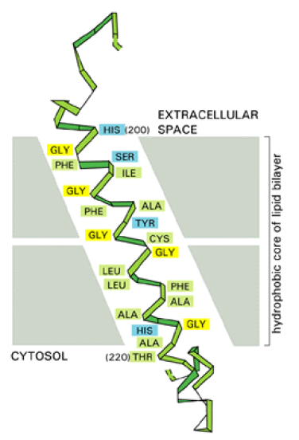
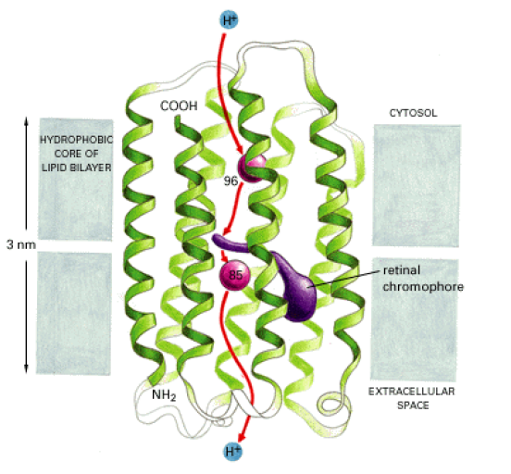
Transmembrane proteins

Slide 15
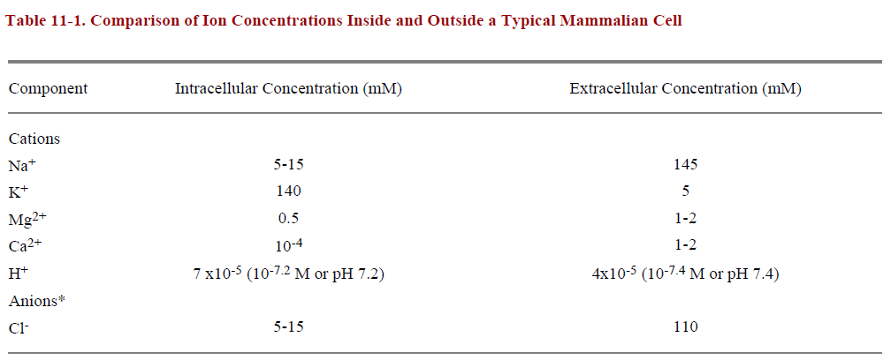
Ionic concentrations in and out of a cell

Slide 16
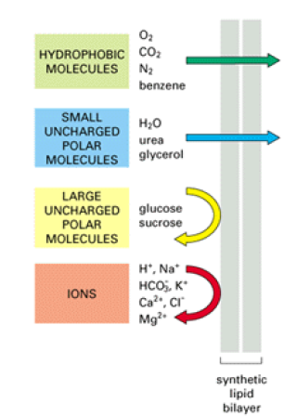
Relative permeability of the membrane

Slide 17
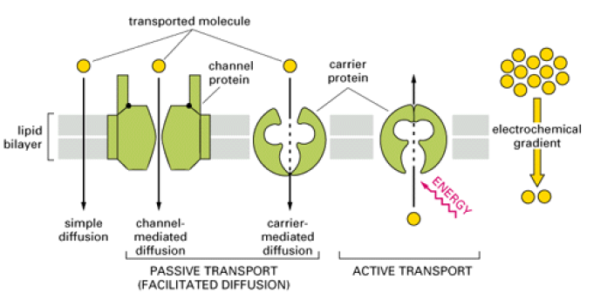
Transport across membrane
Across the concentration gradient- Passive transport (Simple and facilitated diffusion)
Against the concentration gradient- Active transport

Slide 18
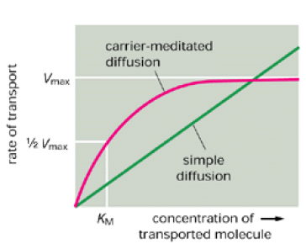
Need of carrier proteins
Passive transport – Difference between Simple and facilitated diffusion.

Slide 19
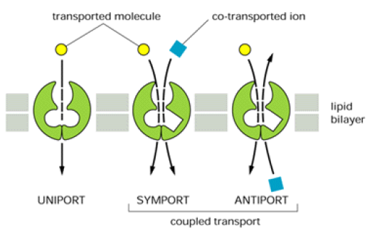
Types of transporters

Slide 20
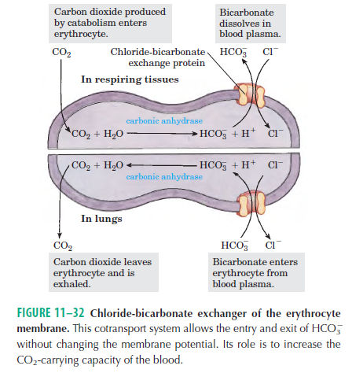

Slide 21
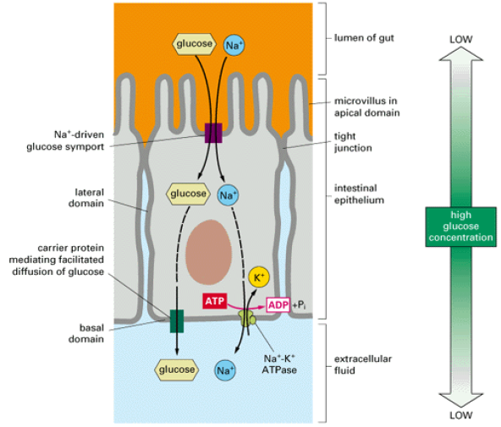
Import of Glucose in cells

Slide 22
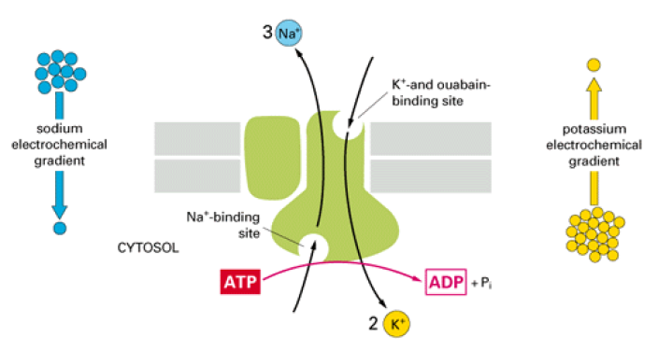
How do transporters work
This carrier protein actively pumps Na+ out of and K+ into a cell against their
electrochemical gradients. For every molecule of ATP hydrolyzed inside the cell, three Na+ are pumped out and two K+ are pumped in.

Slide 23
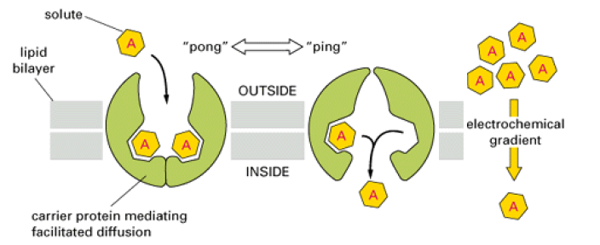
How do transporters work
The carriers protein oscillate between the ‘open’ and the ‘closed’ conformations, famously known as ping-pong mechanisms.

Slide 24
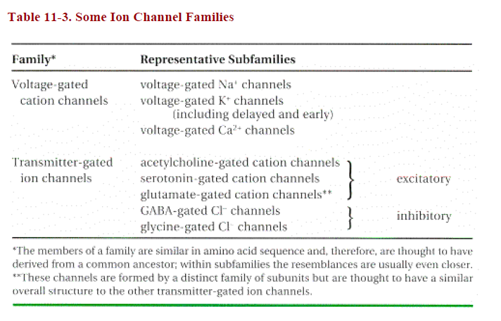
Import of Glucose in cells

Slide 25
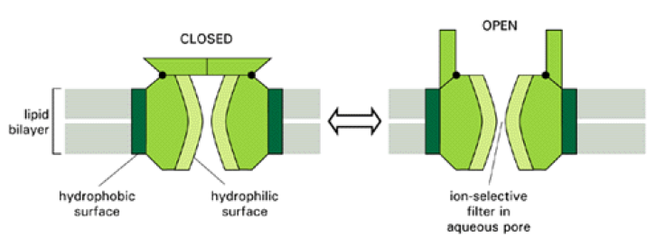
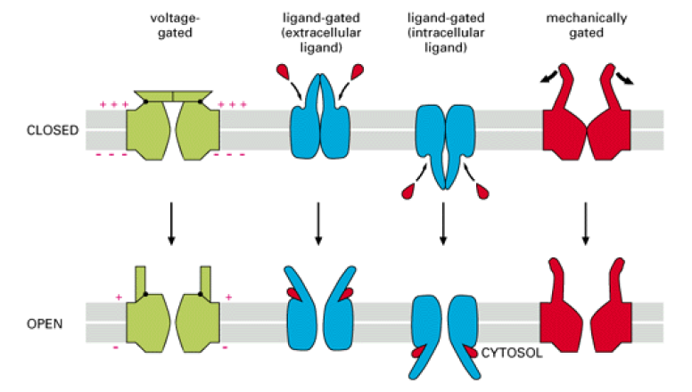
Ion channels

Slide 26
Thank You!

Slide 27
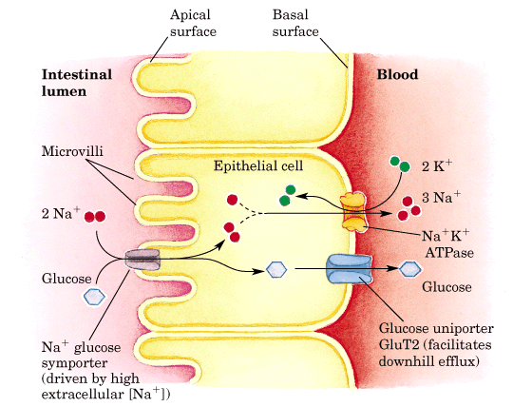

Slide 28
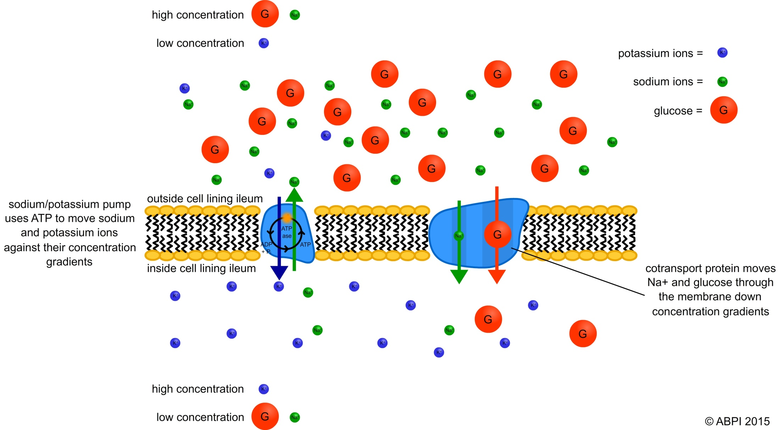
Overview of Glucose metabolism

Slide 29
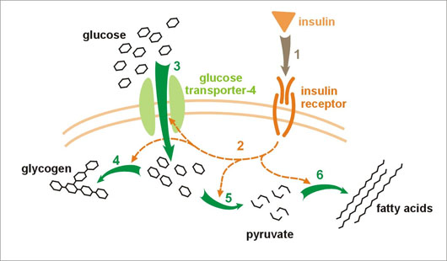
Overview of Glucose metabolism

